Slide 1
Predictive Policing
Lightning Talk
by Harrison Teeter
Ironhack, Fall 2023

Slide 2
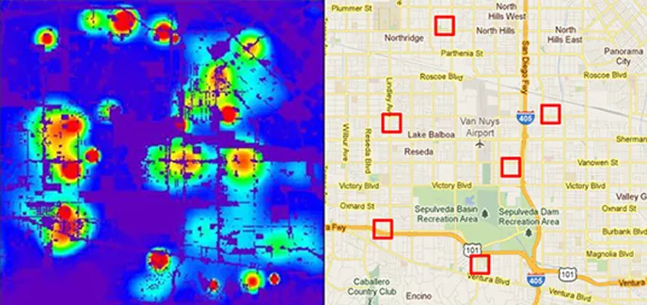
Visualization of the Data

Slide 3
Programs
PredPol – meant to indicate where property crime (such as burglaries or vehicle thefts) has a high likelihood of occuring
Operation Laser – meant to indicate where gun violence has a high likelihood of occuring
Palantir Technologies is the developer of PredPol

Slide 4
Advantages
Prevention of crime – based off data collected, there has been a simultaneous decrease in crime reported in cities where the programs have been implemented
Data-based decision-making – will lead police officers to make decisions based on what data produce rather than personal bias, which could over time make policing more objective
Auditing of police behavior – data collected could conversely reveal patterns of potential abuse of power by police officers and whether any agency is showing patterns of misconduct

Slide 5
Disadvantages
Concerns about privacy rights – data collected is not only public record data, but also from public social media accounts and footage captured by security cameras
Feedback loop – data being entered into a given system may already be biased, which would create biased results, which can lead to further perpetuating discrimination or harden racial profiling
Accountability reduced – when policing becomes based more on algorithms and less on human determinations, it removes some responsibility from the results

Slide 6
Items to consider
Some police departments have suspended their use of the technologies after patterns showed a reiteration of previous policing tactics, nonetheless many departments have reported a drop in crime/successful arrests after the fact
It‘s worth noting that most violent crime victims know their assailants
It‘s also worth noting that most police work involves investigating crimes after they are committed rather than being able to stop crime before/after it‘s happening—hence the eagerness for preventative policing

Slide 7
Weighing the pros and cons
Privacy vs. security
Profiling vs. pre-emptive policing
Community trust in vs. animosity toward police
Potentially reducing crime vs. flare-ups in confrontations with police

Slide 8
Sources
Wired
Brennan Center for Justice
JSTOR
The Guardian
Civil Liberties Union for Europe
The Washington Post
KQED

